Slide 1
MGMT 6055 Project Scope & requirements
LAWRENCE KINLIN SCHOOL OF BUSINESS
MODULE 13
Notes:
Used when no picture is available.

Slide 2
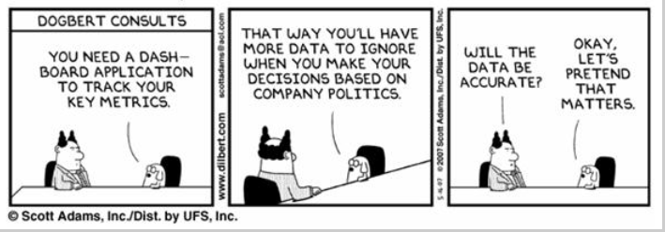
Notes:
https://images.search.yahoo.com/images/view;_ylt=AwrB8pmXVU9W.1QALIAunIlQ;_ylu=X3oDMTIyNTR1MXR1BHNlYwNzcgRzbGsDaW1nBG9pZANiNzFjZGRlODU5MTY3YWY1NzZmMjhjNjhiMWUwMDExMwRncG9zAzEEaXQDYmluZw--?.origin=&back=https%3A%2F%2Fimages.search.yahoo.com%2Fyhs%2Fsearch%3Fp%3Ddilbert%2Bsix%2Bsigma%26fr%3Dyhs-mozilla-001%26fr2%3Dpiv-web%26hsimp%3Dyhs-001%26hspart%3Dmozilla%26tab%3Dorganic%26ri%3D1&w=504&h=350&imgurl=www.qualitydigest.com%2Fmar07%2FImages%2FDilbert.jpg&rurl=http%3A%2F%2Fwww.qualitydigest.com%2Fmar07%2Fcolumnists%2Ftpyzdek.shtml&size=38.0KB&name=Can+we+separate+the+facts+from+the+humor%3F&p=dilbert+six+sigma&oid=b71cdde859167af576f28c68b1e00113&fr2=piv-web&fr=yhs-mozilla-001&tt=Can+we+separate+the+facts+from+the+humor%3F&b=0&ni=21&no=1&ts=&tab=organic&sigr=11rrd3vbd&sigb=14b00sbus&sigi=11e5gt2h4&sigt=119n2u177&sign=119n2u177&.crumb=piZikabS7pr&fr=yhs-mozilla-001&fr2=piv-web&hsimp=yhs-001&hspart=mozilla

Slide 3
Learning Objectives
Control Scope
Project Status Reports

Slide 4
Scope & Project Control
Formally tracking the progress (status) of project activity
As project progresses there is variance to the plan
Project metrics are used to track and report status
The principle of control is measurement, comparison and corrective action
Notes:
4

Slide 5
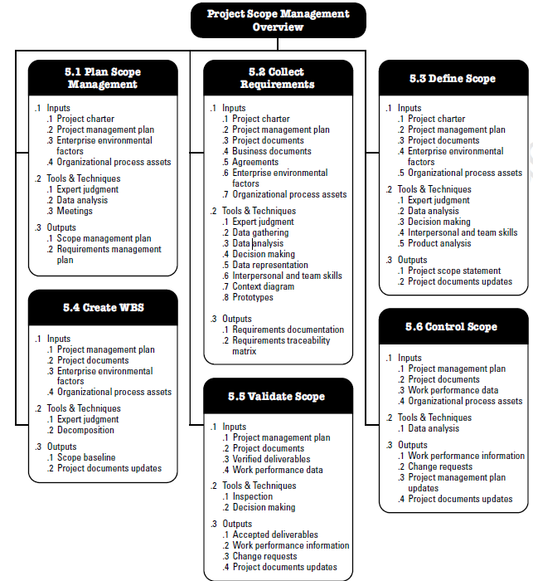
Source: PMBOK (6th ed), pg. 130

Slide 6
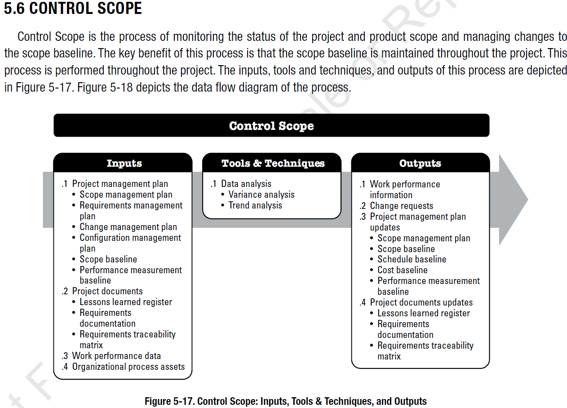
Notes:
Source: PMBOK 6, p. 167

Slide 7
Control Scope - Inputs
Project Management Plan (PMP)
Project Documents (e.g., BRD, requirements traceability matrix, lessons learned register)
Work Performance Data (the current status of work in progress, completed work, and work to be completed)
Organizational Process Assets
You’ve seen these inputs before, in some of the earlier PMBOK processes we studied.

Slide 8
Control Scope - Tools and Techniques
Data analysis - Variance analysis
Used to assess magnitude of variation on the project
Baseline versus actuals
Comparing what you should be doing with what you’ve actually done
Data analysis - Trend analysis
Used to assess performance over a span of time
Project managers control the schedule and the budget in a similar way. They compare planned versus actual results. If there’s a difference (a variance), project managers need to decide what further action is needed (if any).

Slide 9
Control Scope - Outputs
Work performance information (planned vs. actuals, status reports for management, etc.)
Change requests (if work needs to be changed – more on this next week!)
Project management plan updates (e.g., if the project baseline needs to be changed)
Project documents updates (e.g., if the Requirements Traceability Matrix needs to be updated)

Slide 10
Project Status Reports
This is a regularly scheduled activity to the senior management of the Project Management Office (PMO) and/or other stakeholders
‘To the point’ reporting – high-level summaries, not a lot of detail
The focus is on hearing about problems and proposed solutions
See “What Goes Into a Project Management Status Report?” (6:55) - https://www.youtube.com/watch?v=5mvXSAJgqec

Slide 11
Project Status Reports
Project Status Reports often contain colour coded (red/yellow/green) graphics and information boxes
Known as ‘project scoreboards’, ‘project scorecards’, or ‘project dashboards’
There are many examples of status report templates online!

Slide 12
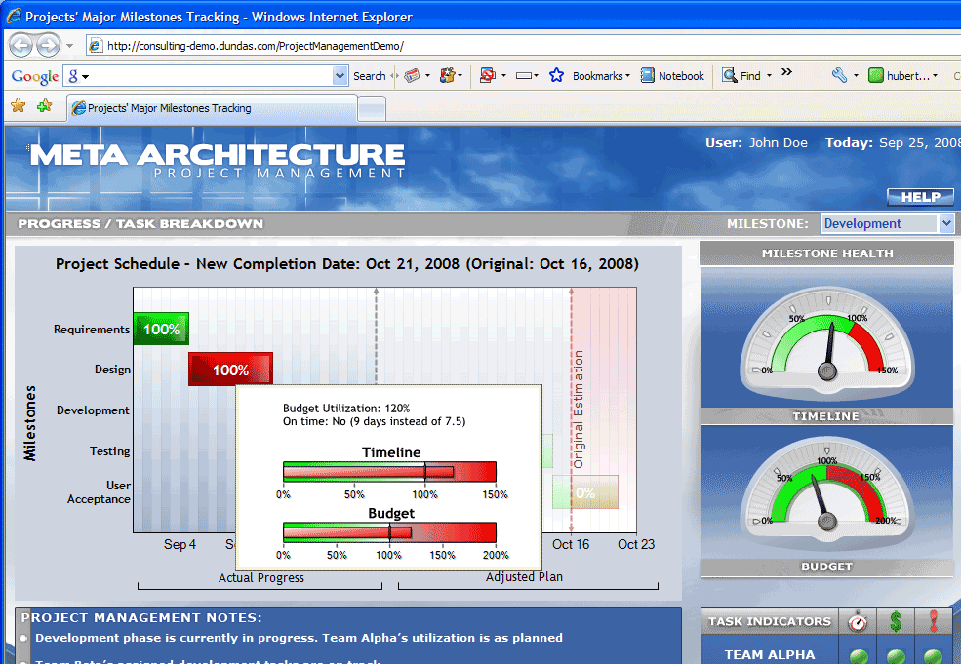
Project Status Reports: Example of Project Scoreboard/Dashboard

